Slide 1

mobile merchant APP
Mobile Payment 2.0
user guide
“Connecting the World with Mobile Payment One Country at a Time”
PRIVATE & CONFIDENTIAL

Slide 2
Mobile merchant APP user guide
Introduction
Installing the APP
2.1 Downloading the APP
2.2 iOS installing
2.3 Android installing
Use the APP
3.1 Merchant
3.1.1 Login
3.1.2 Payment
3.1.3 Cashier management
3.1.4 Transaction management (Review & Refund)
3.2 Cashier
3.2.1 Login
3.2.2 Payment
3.3 Forget your password
3.4 Settings

Slide 3

introduction
HaoJin ICON
Pay Merchant APP
Helps the merchant collect money with QR code technology
Provide Membership and Loyalty programs, Meal Ordering System and Developer Platform, Incentive Payment, referral Bonus.
Developed by: Beijing Qfpay Technology Company Limited
Website: http://www.qfpay.com/global/

Slide 4
Downloading the app
iOS
Android
To download the Merchant App, you could:
Click the link Qfpay provided in on-boarding email, it will directly lead you to download page
Insert ‘HAOJIN’ in the search bar of your mobile App Store (shows as the left pictures)
Note: depending on the country you located in, the app could possibly go by a different name, so the provided-link would always be the first option.

Slide 5
installing the app – ios
For iOS devices, when you open the APP after downloading, there is a chance you may get a notification called
‘Untrusted Enterprise Developer’
DON’T WORRY!
It could be solved perfectly in a few easy steps.

Slide 6
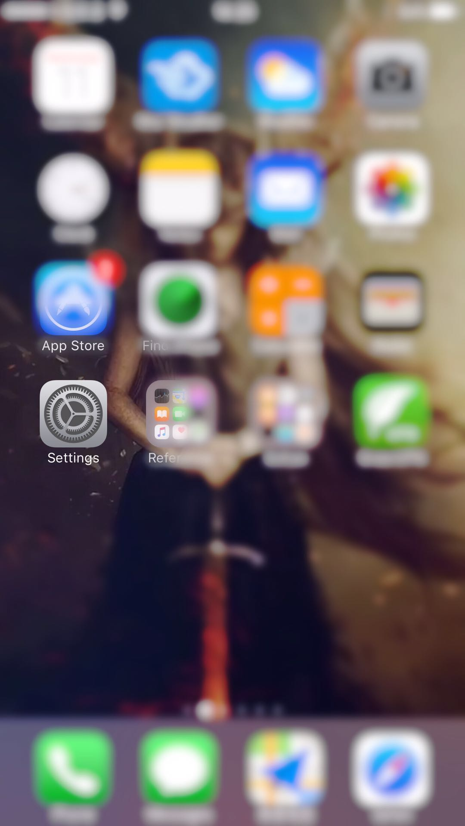
Installing the app – ios
Step 1
Find ‘Settings’ on your mobile
Step 2
Open ‘Settings’, Click ‘General’

Slide 7
installing the app – ios
Step 3
Swipe screen, reach to ‘Device Management’ and open it
*It will show as ‘Profile & Device Management’ if you have multiply app developers
Step 4
Then tap open ‘Beijing Qfpay Technology Company Limited’ for more detail

Slide 8
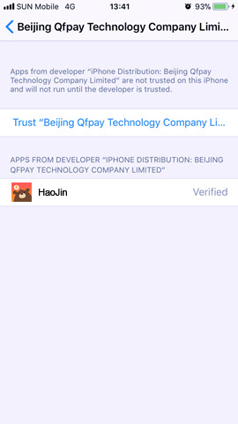
installing the app – ios
Step 5
Tap on ‘Trust “Beijing Qfpay Technology Company Limited”’ to verify the APP.
Step 6
It will show as ‘Verified’ once succeed.
ALL DONE!
Now open HaoJin and enjoy.

